Slide 1
Lecture -4
Structs: d.s. Malik chapter 11
Object oriented Programming
Spring 2024

Slide 2
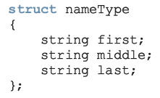
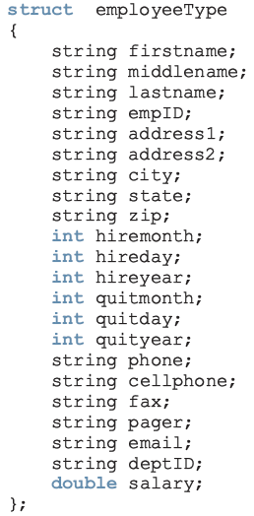
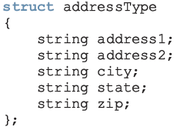
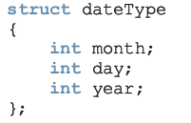
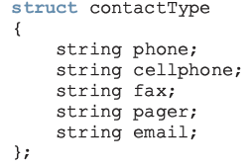
Struct within struct
repetition

Slide 3
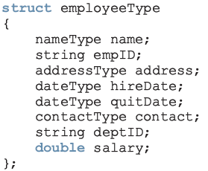
A better form of employeeType
Easier to manage
Some of this struct can be reused to build another struct
e.g., if we want to build a customer’s record. Every customer has a first name, last name and middle name, as well as an address and a way to be contacted

Slide 4
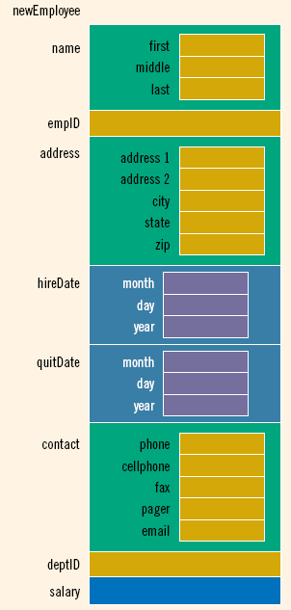
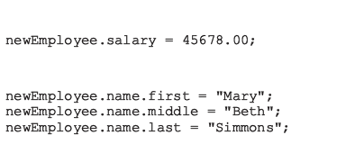

Slide 5
Example: StudentType
We want to implement a neon like system. For this purpose we need to store following information about each student.
Name, roll number, address (complete address, city , state , zip), Date of Birth, batch, discipline, total credits earned, cgpa, result of 5 courses.
We store following information about each course Result
Course Name, course code, credit hours, total marks, Grade
Our data is stored in two files:
One file has all the personal information about each student (Name, roll number, address (complete address, city , state , zip), Date of Birth, batch, discipline)
Other file has details of all 5 course except Grade
Assume both files are sorted by roll number. This means that personal data of the student with roll number 1 is first line of file1 and his/her courses details are in first line of file2.
We want to store details of 100 students.
Read data from file into arrays
Assume we are updating data for first semester students who have cgpa =0 and total credits =0
After reading data from both files, we want to update
Compute and update Grade of each course
Calculate and update Cgpa and total credits earned

Slide 6
Methodology
Identify structs
Make sample files
Identify all possible functions
Write prototypes
Use graphical approach

Slide 7
Quiz -1 about structs on Thursday 7th feb 2013

Slide 8
Pointers

Slide 9
References
Chapter 14, D.S. Malik, C++ Programming, 5th edition
Chapter 8, Dietel & Dietel, C++ how to Program, 7th edition

Slide 10
Computer Memory
Each byte in memory has an address just as they are for houses
If we have 1 MB of memory, the highest addresses are in range 0 to 1,048,575
The program when loaded into memory occupies a certain range of these addresses
Every variable and function has some address

Slide 11
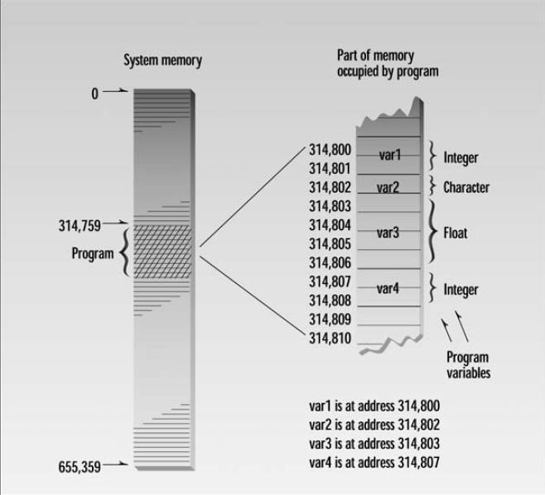
Taken from Ch. 10, Pointers, Object Oriented Programming in C++, Robert Lafore

Slide 12
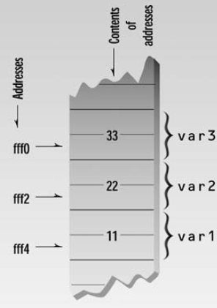
The Address-of Operator &
#include <iostream> using namespace std; int main() { int var1 = 11; int var2 = 22; int var3 = 33; cout <<&var1<<“\n”; cout<<&var2<<“\n”; cout<<&var3<<“\n”; return 0; }
Each location in memory has some address and some content(Value)

Slide 13
The actual addresses occupied by the variables in a program depend on many factors
Computer the program is running on
The size of the operating system
Whether any other programs are currently in memory

Slide 14
What is a pointer?
A variable that can hold address
Declaration:
dataType * pointer name;
int * p;
int n=10;
p=&n;
Asterik means pointer to
dataType of a pointer is the dataType of the variable this pointers is pointing to.
0x100
0x100
10
p
n

Slide 15
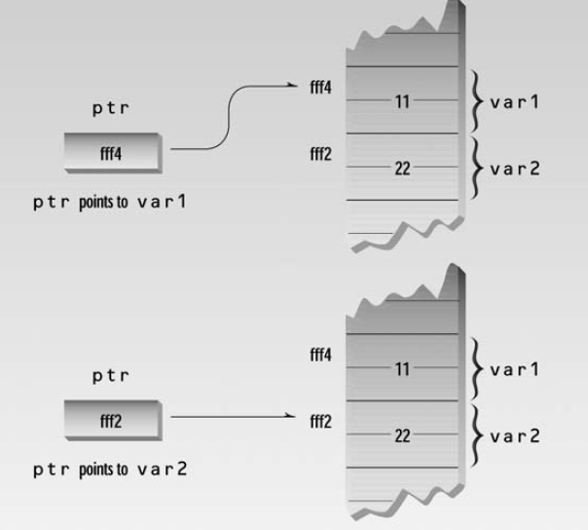
int main()
{
int var1 = 11;
int var2 = 22;
cout << &var1 << &var2 ;
int* ptr;
ptr = &var1;
cout << ptr << endl;
ptr = &var2;
cout << ptr << endl;
return 0;
}

